Slide 1


GOOGLE DATA ANALYSIST CERTIFICATION
CYCLISTIC
CASE STUDY
ULLAS KUMAR BHERAV

Slide 2

TABLE OF CONTENT
01
02
03
04
05
06
ABOUT PROJECT
DATA SOURCE USED
CLEANING
ANALYSIS
VISUALIZATION
RECOMMENDATIONS

Slide 3

ABOUT PROJECT
Cyclistic, a bike-sharing company in Chicago is focusing on increasing its annual members. there are two kinds of customers casual riders and annual riders, the company wants to understand their patterns and wants recommendations
The Three main Questions are:
how annual and causal riders use services differently.
why would casual rider by membership
how can we use digital media to create infulence.

Slide 4

DATASET
The datasets consist of rides detail with the rideable type, start and end time with date, start and end station name, start station id, and end station id and member type. The datasets contained information about first quaters, first quarter of 2020, and the second, third, fourth quarters of 2019.

Slide 5



DATA CLEANING
BIAS
FINDING NULL VALUES.
FORMATTING
The data was checked for biasedness but no such issues were found. the data didn't reflect any false or impartial data
The data used for analysis didn't have any missing values.
Data columns were formated according to their value format for easier and faster computation.

Slide 6

DATA CLEANING
MERGING
The first step for analysis was the merging of data. the four CSV files were uploaded to r studio, where I kept the quarter_one_2020 column names and changed others to the same.
Afterward, I merged these four datasets into a single dataset, "trips".
There were few columns such as longitude and latitude which were not necessary and were not available with every quarter so they were removed.
A new data column was added, "Ride_length" which gave information about the time duration users used services.

Slide 7


ANALYSIS
R STUDIO
R Studio, Used for data visualization and analysis was used for carrying out this project. once the data set was ready columns such as weekdays, Ride length according to month were added for
analysis of data. Other steps used were:
dimension, a summary of the dataset was generated for analysis o data.
The name values were made consistent in the member_casual column to member and casual.
mean, median, max were calculated .

Slide 8
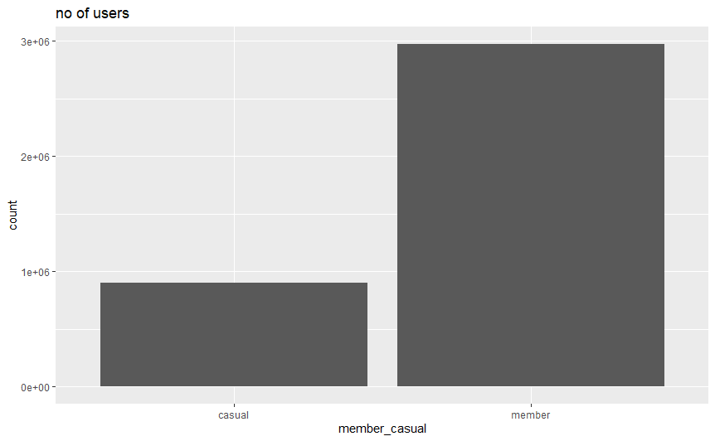
VISUALIZATION
The one Visualization shows the comparison between members and casuals vi bar chart. key finding are:
annaual members are 3,000,000
casual members are 900,000
the annual members are comparitively higher than casual which shows the compay is working great.

Slide 9
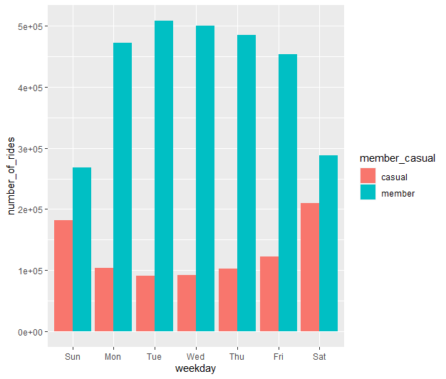
VISUALIZATION
The second Visualization shows the comparison between weekdays and the number of rides. Findings are:
member usage sees significance rise on working days and declines on weekends
casual users see a rise on weekends and a decline on working days.

Slide 10
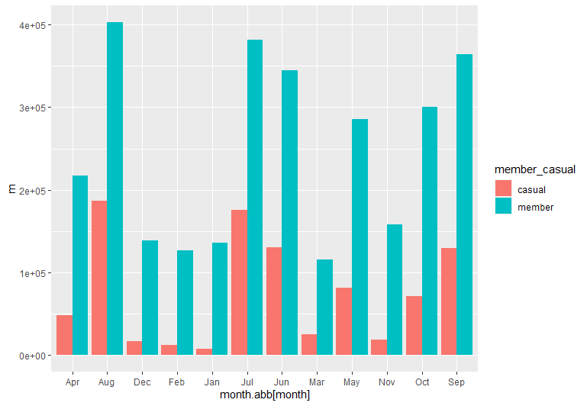
VISUALIZATION
The third Visualization shows the comparison between months and the number of rides. Findings are:
member usage sees a significant rise in summers with Jun, Jul, Aug, Sep, and Oct being the services getting used the most.
casual users see a rise in summer seasons and a serious decline in winter months, ( Jan.Feb,March)

Slide 11

RECOMMENDATIONS.
SPECIAL BENEFITS ON WEEKENDS/ WORKDAYS
Casual Users are using the services on weekends. These users can be given benefits and discount plans on membership, so they can use these services as their primal source of transport.
Members should also receive discounts or maybe a free service based upon coupon services so the member is using these services on weekends.

Slide 12
RECOMMENDATIONS.
ADS/ SOCIAL MEDIA
casual members can be targeted with advertisements and benefits for these services.
casual members can be motivated to opt for services for daily travel means, for this, a survey can be collected asking about their wor addresses. The customers with the nearest work addresses o their homes can be contacted and can also receive discounts and a trial of the services.
Additional services such as discount vouchers of various brands can also be provided with the subscription for luring customers.

Slide 13
RECOMMENDATIONS.
WINTER ARRANGEMNTS
Whether it's a member or a casual rider both see a serious drop in the winter season. This is because people ignore to use cycle's in winters due to cold weather.
for winters, the company can provide casuals and annual members with winter outfits,(mufflers, gloves, caps, jackets).
The company can also tie up with food chains to provide food to customers at a discounted rate.
The company can start a rental service for cycles for more convenience.
for members, family plans can be launched where the second member can get discount on services.

Slide 14

CONTACT
kumarullas30@gmail.com
https://www.linkedin.com/in/ullas-kumar-bherav-2058b813b/
7018810276
https://twitter.com/UllasKu12676573

Slide 15

THANK YOU

